Slide 1

MLPQ Mushroom Database and Classifier
Oleksiy Al-Saadi, Fateh Sandhu, Justin Lang, Sarah Roscoe

Slide 2

Motivations/Goals - Overview
Create a database system that holds characteristics for different types of mushrooms
Predict whether a mushroom is edible or poisonous with the help of Data Mining
Can be used by hikers, hunters, trekkers, and more outdoor enthusiasts.
Nebraska Mycological Society member records
Animations for Casual Hobbyists
Notes:
Oleksiy

Slide 3
Design Overview
The entire database was setup in MLPQ with the help of Python to create MLPQ ingestion files
SQL queries can be used within MLPQ to extract useful information by the end users.
Scikit-Learn was used to build SVM and SVC models with high accuracy
Notes:
Fateh/Oleksiy

Slide 4
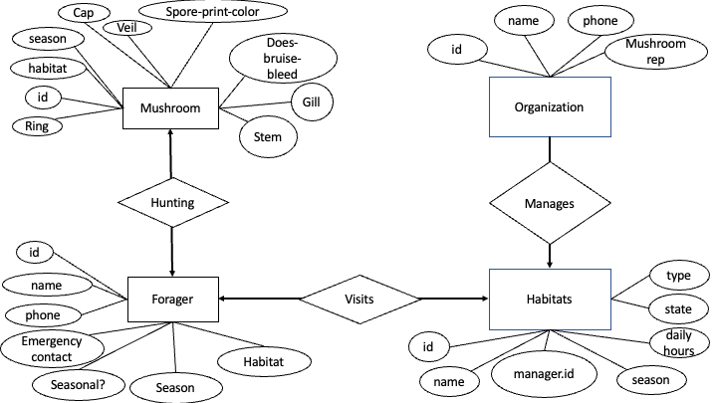
Entity Relation Diagram
Notes:
Sarah

Slide 5
Data Sources
Initial dataset was downloaded from UCI Machine Learning Repository ~ 8100 records
After more exploration, we found a better dataset with accurate numerical data from Philipps University Marburg ~ 61000 records
The new dataset was better to work with and had much cleaner data with no missing attributes.
All data used in the project was open-source.
Notes:
Fateh

Slide 6
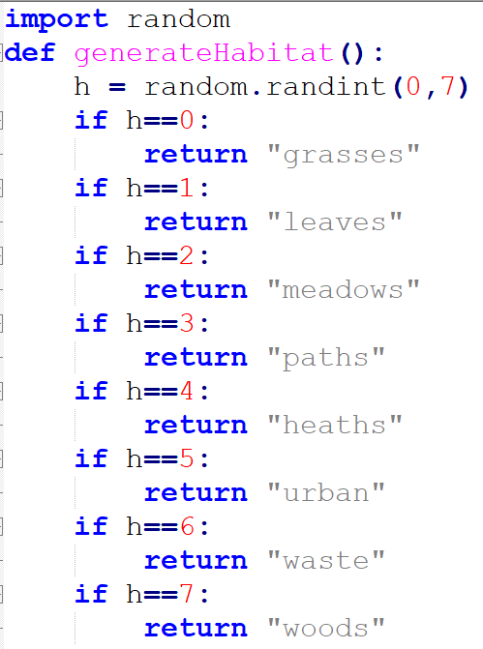
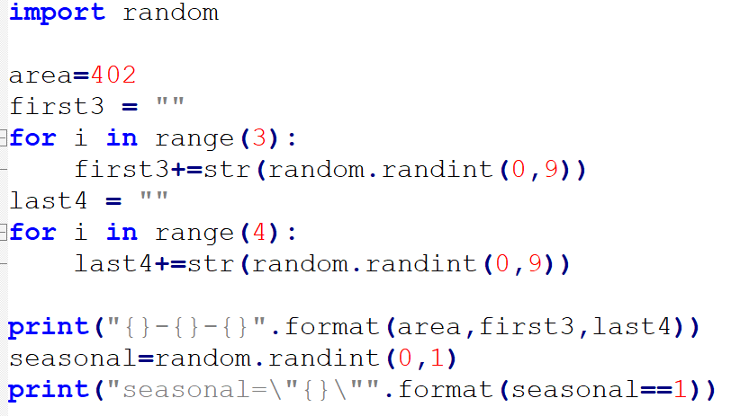
Data Sources
Forager, Habitat, and Manager tables were created with random generators
Python programs were written to make “decisions”: habitat/season interests, phone numbers
All data used in the project was open-source.
Notes:
Sarah

Slide 7
Data Transformation
Due to the limitation of MLPQ, we had to reduce our ingestion to only 1000 records.
We built 2 different models.
using all characteristics - 99% accurate model
using stem-height and cap-diameter - 56% accurate model
We ended up using the model with only two features due to limitations in hyperplane visualization.
Notes:
Fateh

Slide 8
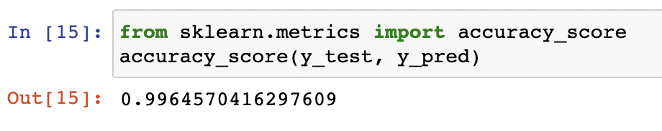
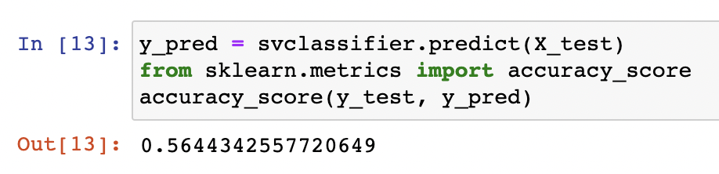
SVM Models
Model 1 : Original dataset, all features.
Model 2 : New dataset, two features.
y = -7.321893202372813x + 91.89064823107132
Notes:
Fateh

Slide 9
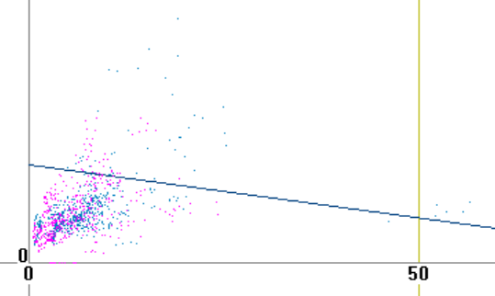
Cap Diameter vs. Stem Height
Plotted in MLPQ
As stem height gets bigger than cap diameter, it is more likely to be edible. Such mushrooms we label as “Oblong”
There is no single pair of attributes which can accurately classify mushroom edibility.

Slide 10
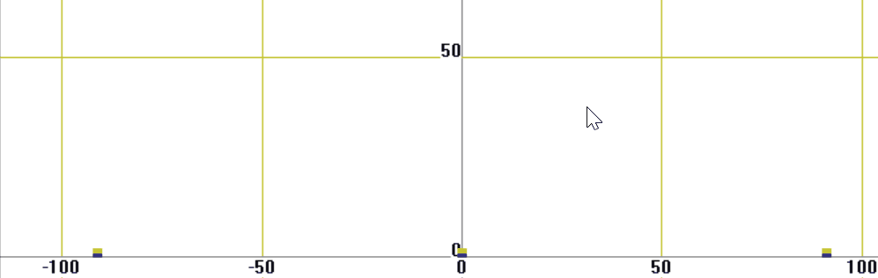
Cap Diameter vs. Stem Height Animation
Users may want to know the general ratio of mushroom sizes used in categorization:
Dwarf, Normal, Oblong

Slide 11
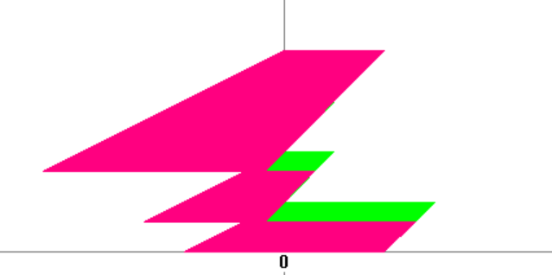
Cold and Warm Constraints
We visualize these sizes using MLPQ’s inherent constraint database in two weather conditions. It is well known that warm mushrooms tend to have larger stem height. In this example, stem height and cap diameter are limited to 20.

Slide 12
Use Cases

Slide 13
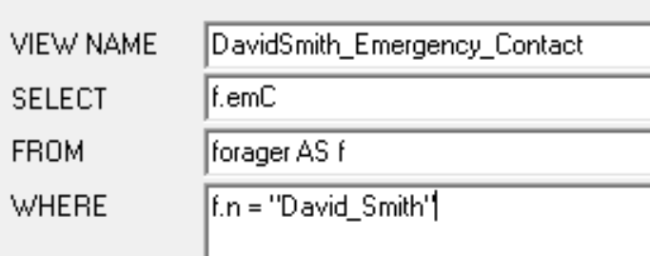
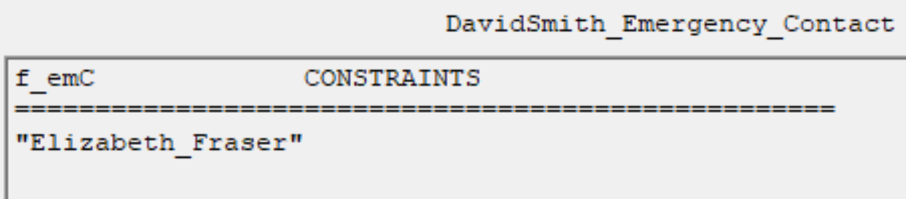
Queries
David Smith was searching for mushrooms in Platte River State Park but got lost. The park rangers want to reach David's emergency contact. Who should the rangers call?
Notes:
Justin

Slide 14
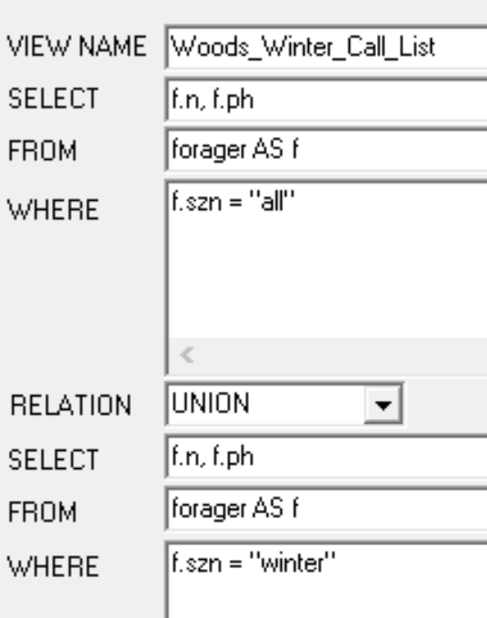
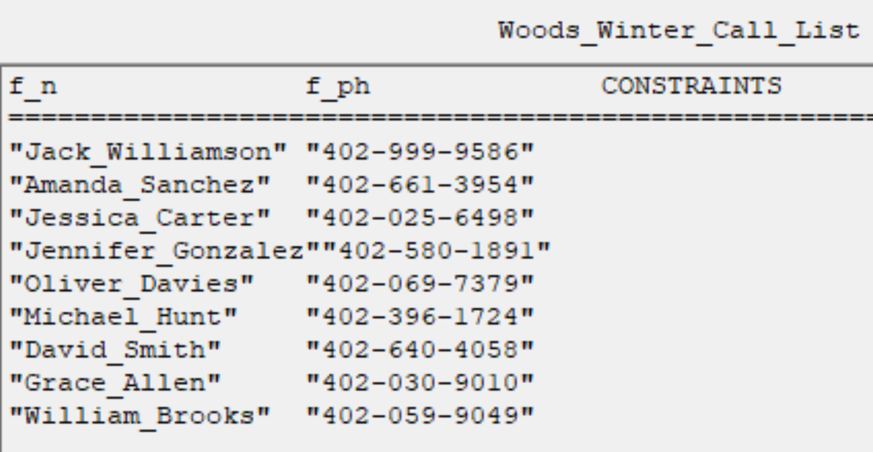
Queries
Jeffrey Willis at Nebraska Game and Parks has heard about some really cool "woods" mushrooms growing in winter. He wants the phone numbers of all interested winter foragers to tell them about this amazing discovery. Find the list of people he should call.
Notes:
Justin

Slide 15
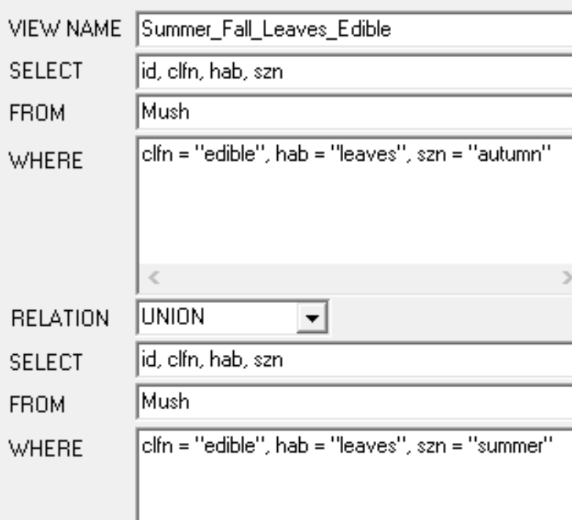
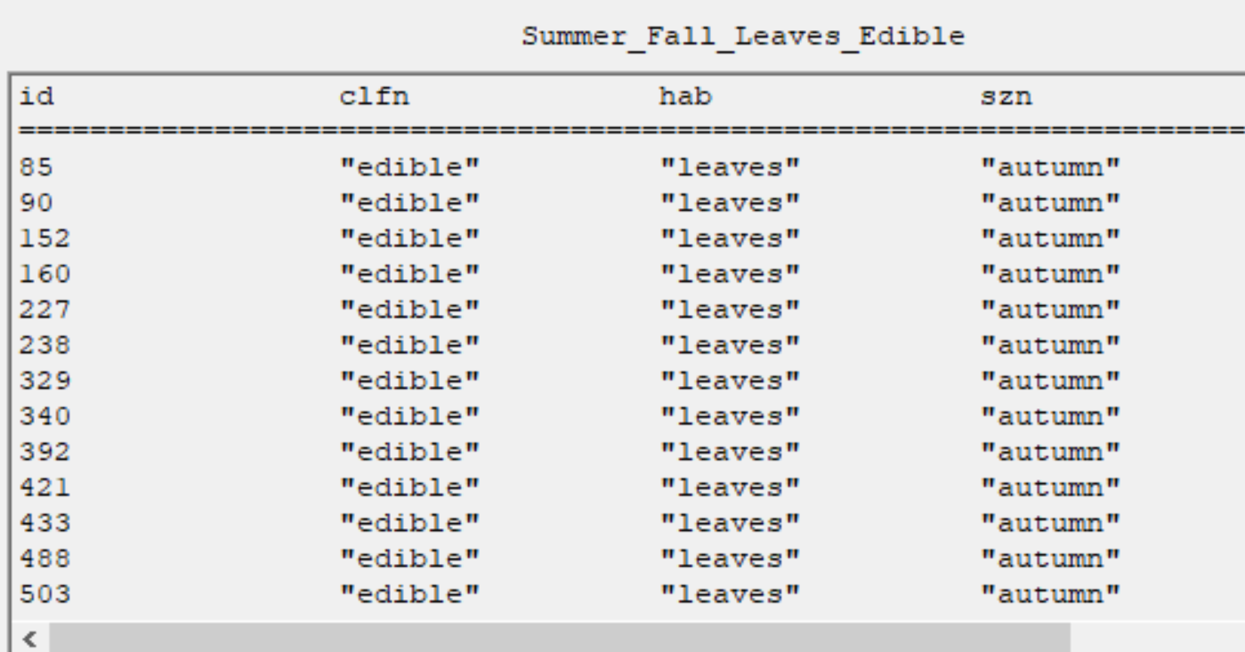
Queries
Heather Mason is wondering whether any mushrooms in her interests (summer/fall, leaves/woods) are edible. Find a list of edible mushroom IDs matching these descriptions.
Part 1:
Notes:
Justin

Slide 16
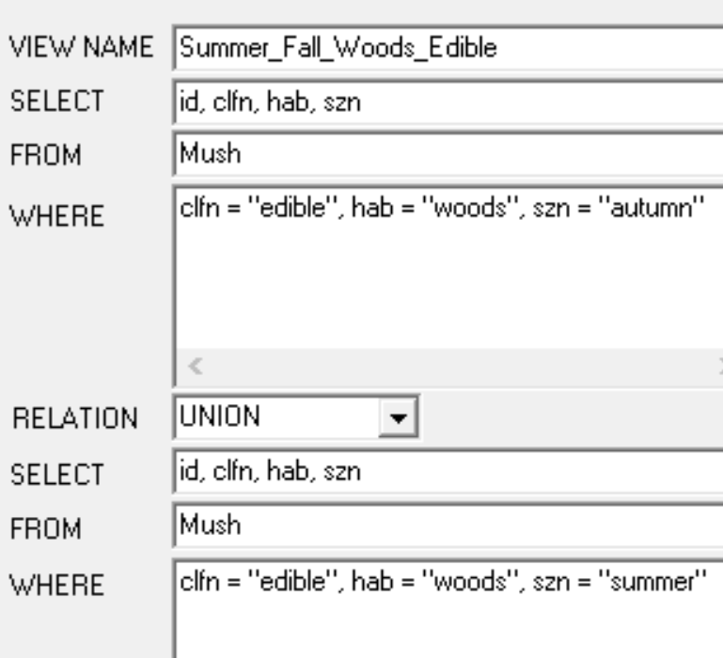
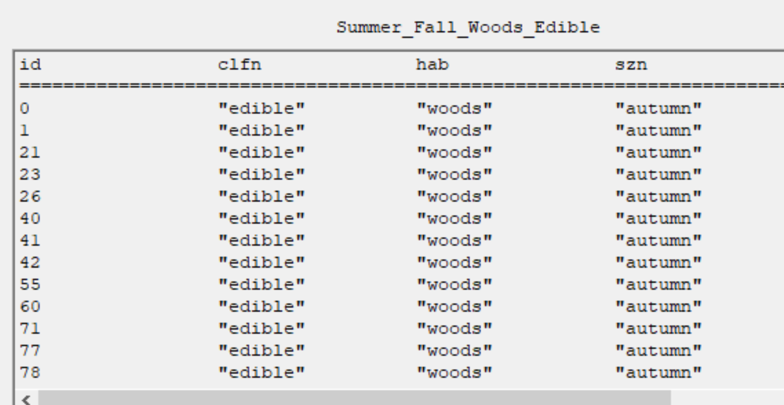
Queries
Heather Mason is wondering whether any mushrooms in her interests (summer/fall, leaves/woods) are edible. Find a list of edible mushroom IDs matching these descriptions.
Part 2:
Notes:
Justin

Slide 17
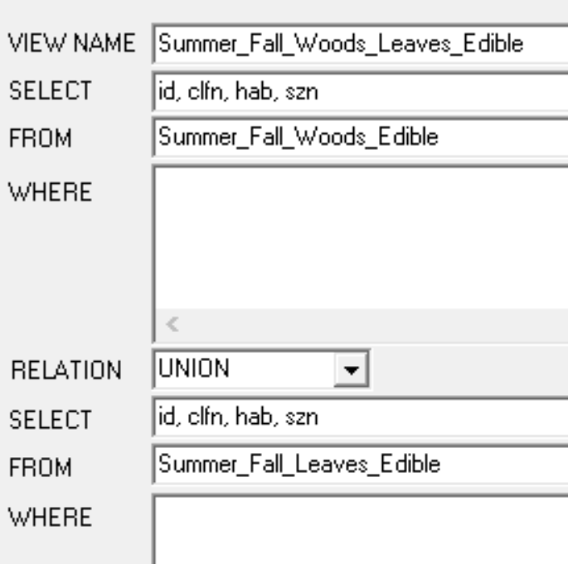
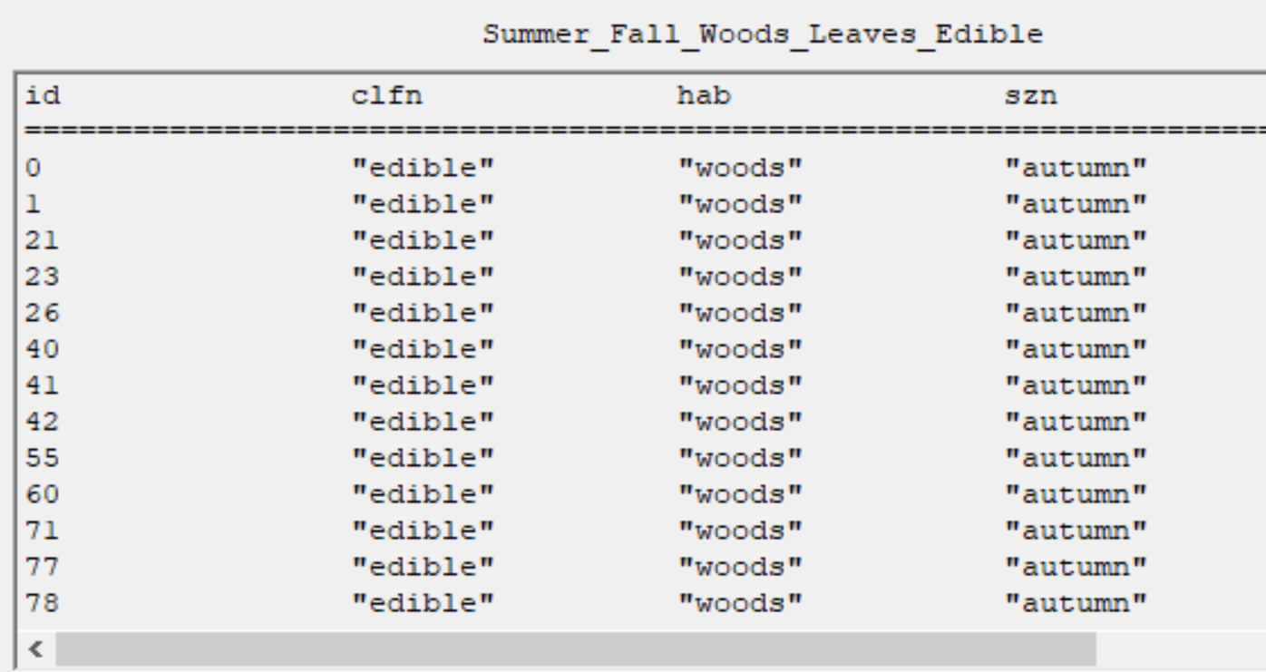
Queries
Heather Mason is wondering whether any mushrooms in her interests (summer/fall, leaves/woods) are edible. Find a list of edible mushroom IDs matching these descriptions.
Part 3:
Notes:
Justin

Slide 18
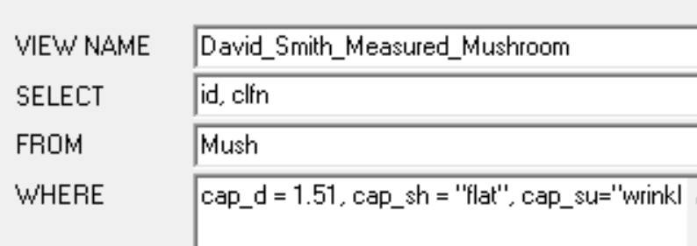
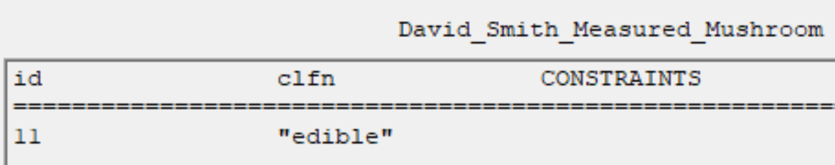
Queries
David Smith found a mushroom and measured its attributes. It has a gray, flat, wrinkled cap with diameter 1.51 cm. It does not bleed when bruised. Its stem is white, 5.2 cm high and 2.57 cm wide. There is no ring. It was found in grasses in the winter. What instances of mushrooms fit this description, and are any of them edible?
Notes:
Justin 15m mark

Slide 19
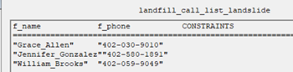
Queries
In early winter, the Lincoln Landfill must close early because of a small landslide. Matthew Bradley, the mushroom rep, knows there are regular "waste" mushroom hunters in the afternoon. Find the list of people he should call to tell them they can't come today.
CREATE_VIEW landfill_call_list_landslide
SELECT n,ph
FROM forager
WHERE hab="waste", szn=”winter”
Notes:
Sarah

Slide 20
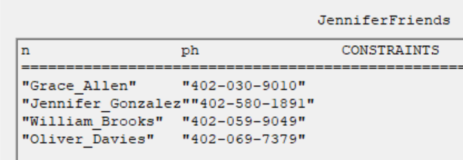
Queries
Jennifer Gonzalez is new to mushroom hunting and wants to know who else may share any of her season or habitat interests. Find the list of potential people she can go mushroom hunting with!
CREATE_VIEW JenniferFriends
SELECT1 n,ph
FROM1 forager
WHERE1 hab = "waste"
INTUNION UNION
SELECT2 n,ph
FROM2 forager
WHERE2 hab = "grasses"

Slide 21
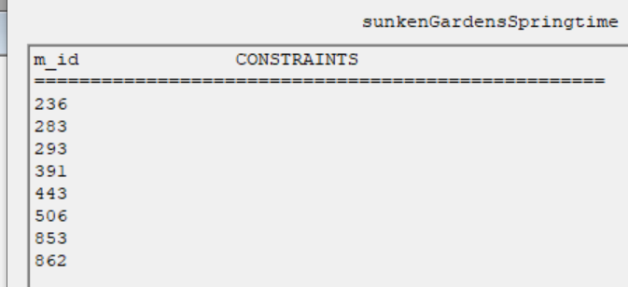
Queries
CREATE_VIEW sunkenGardensSpringtime
SELECT m.id
FROM Mush as m, habitat as h
WHERE h.type=m.hab, h.n="sunken_gardens", m.szn="spring"
List the IDs of all mushrooms that may appear in the Sunken Gardens in springtime.

Slide 22
MLPQ Limitations
After using the MLPQ system for analysis, we suggest the following upgrades:
Allow for more records, longer lines
Unbounded constraints
Variables within animations
Future idea:
Image classifier tool
Importing 99% accurate model to MLPQ using all characteristics
Notes:
18m/20 mark

Slide 23
Thank you for listening!
Any questions?

Slide 24
Additional Use Cases

Slide 25
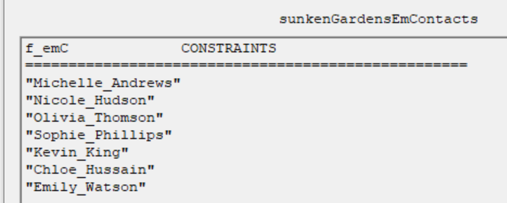
Queries
Stephanie Young of Lincoln Parks and Rec is hosting a mushroom-hunting party at the Sunken Gardens, but due to coyote sightings in the area, she needs the emergency contact name of each person who might come to the event.
CREATE_VIEW sunkenGardensEmContacts
SELECT f.emC
FROM forager as f,habitat as h
WHERE h.type=f.hab, h.n="sunken_gardens"

Slide 26
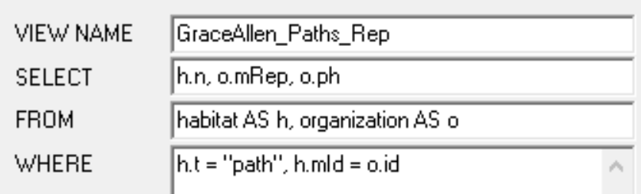
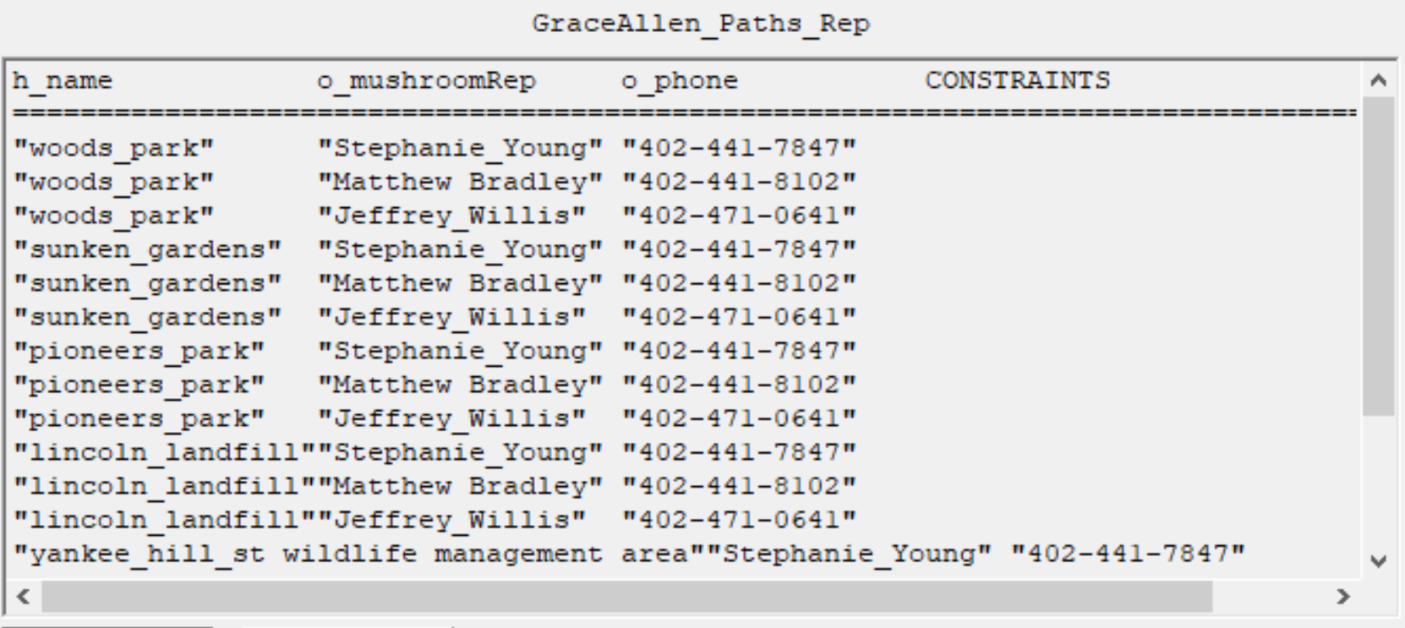
Queries
Grace Allen wants to know which nearby areas will have mushrooms on paths. Which mushroom reps should she call?
When Grace calls the people on her list, what locations will they recommend?
Notes:
Justin

Slide 27
Challenges while building SVM Models
Learning how to use Scikit-Learn to build models
Extracting only useful features
Converting data into ordinal data to be used by Scikit-Learn
Using classifier to build a hyperplane equation that can be imported and interpreted by MLPQ and database users
Notes:
Fateh

